Slide 1
Agenda
Typical process flow for Action Items
New fields and metrics now available
“Status” field nuances
Revised email notification
New reporting
Interacting through Info Exchange website and Mobile Apps
Creative uses of Action Items

Slide 2
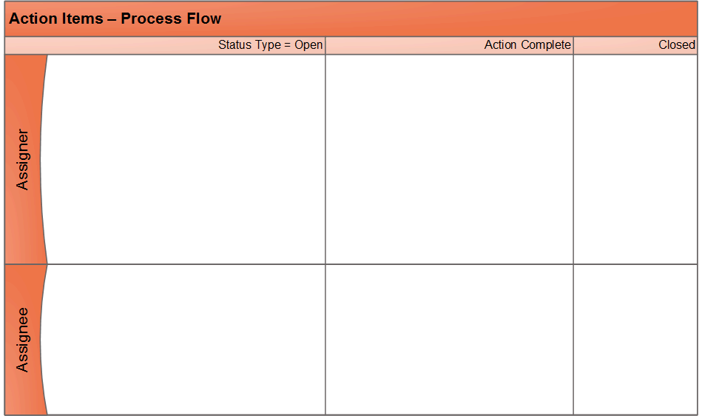
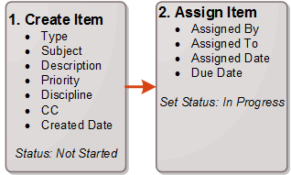
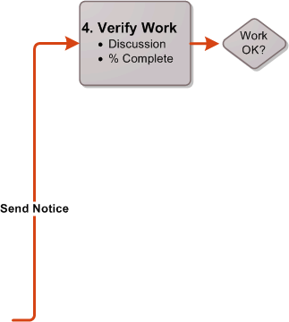
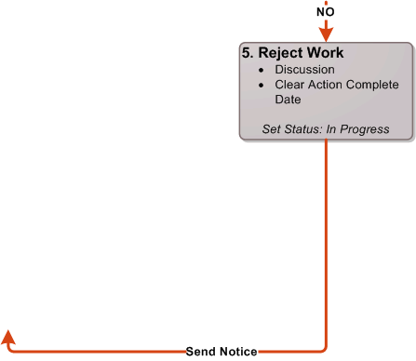
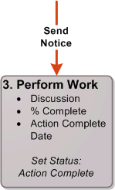

Slide 3
Lots of Interfaces
Project Center client
Info Exchange website
Mobile apps:
Capture, Plans, Tasks
Embedded in activity centers:
Meeting Minutes, Site Visits, Daily Reports

Slide 4
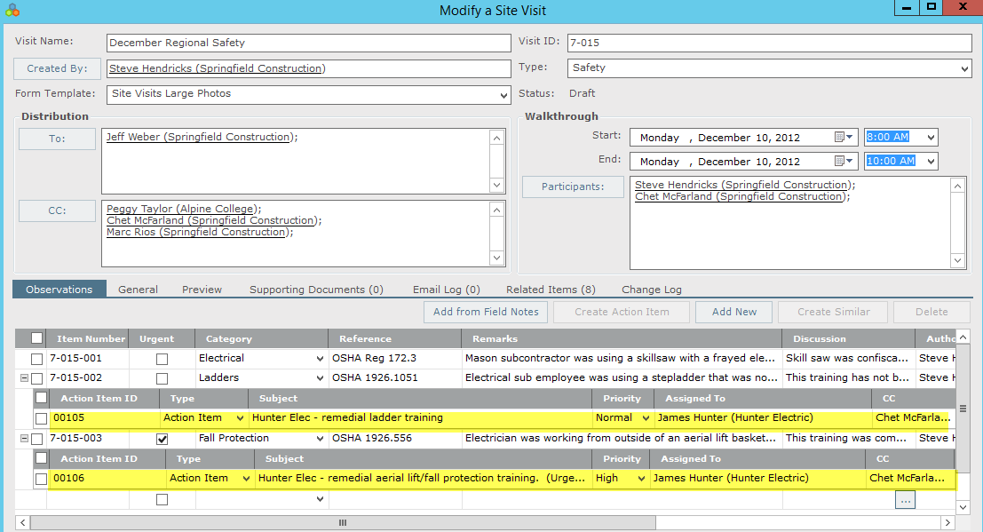
Embedded in Observations

Slide 5
Track 5 Dates
Created captured or added
Assigned sent to the responsible person
Due Date when item should be finished
Action when the responsible person Complete finished the task
Closed work verified & accepted
Assigned automatically – no editing

Slide 6
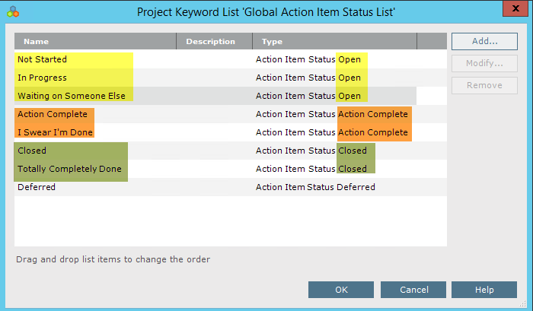
Status Field Pushes the Workflow

Slide 7
Demonstration

Slide 8
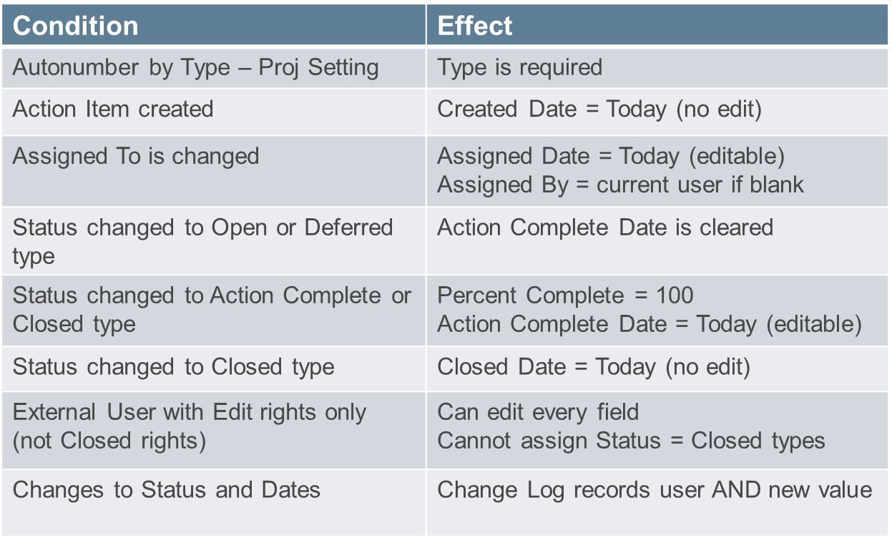
Business Rules

Slide 9
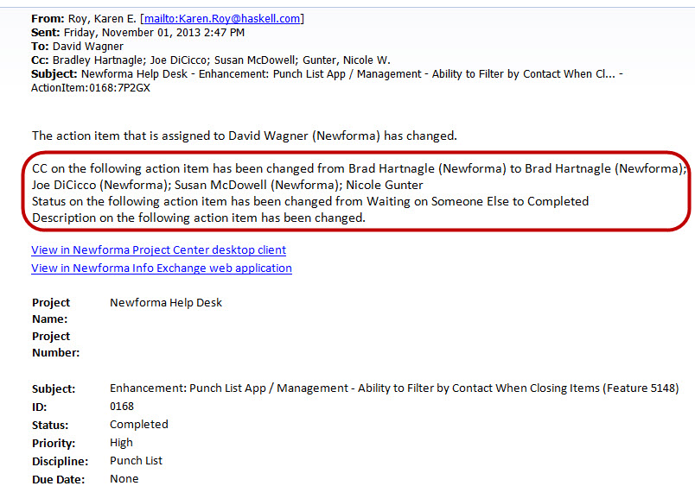
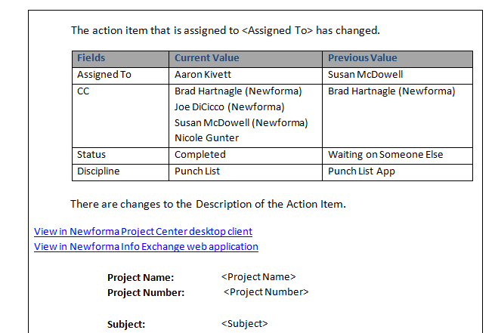
Email Notifications

Slide 10
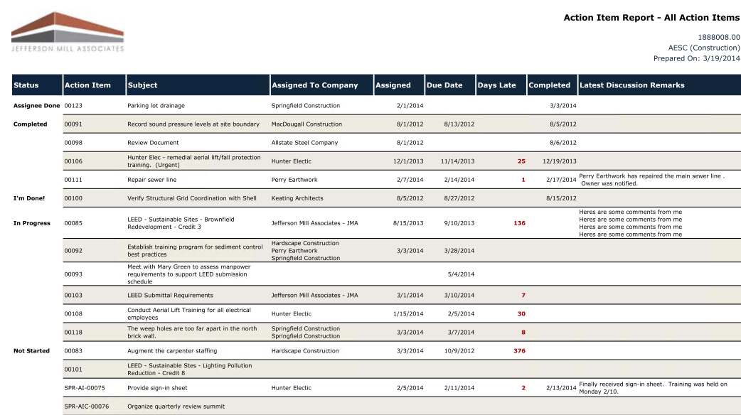
Reporting Possibilities

Slide 11
Creative Uses of Action Items
Project Management tasks
Pre-set typical milestones by project type, like design deliverables
Accounts Payable – invoice approval
Grouping own email by topic
Quality – continuous improvement items
Departmental tasks – HR onboarding of new employees, applicant tracking, performance reviews, BD proposal milestones

